Slide 1

Android Operating System

Slide 2
Overview
Definition of Android Operating System.
Features of Android Operating System.
Architecture of Android OS.
Privacy Leakages in Android.
Privacy Leakage Identification Methods.
Permissions in Android.
Permission vs. Privacy Leakage.
Trusted vs. Untrusted Apps.
Privacy Risks vs. Trusted & Untrusted Apps.
Privacy Risk Assessment.
Risk Assessment Methods.

Slide 3
Android Operating System
Android is a mobile operating system based on a modified version of the Linux kernel and other open source software, designed primarily for touchscreen mobile devices such as smartphones and tablets.
Most versions of Android are proprietary. The core components are taken from the Android Open Source Project (AOSP), which is free and open-source software (FOSS) primarily licensed under the Apache License.
The source code has been used to develop variants of Android on a range of other electronics, such as game consoles, digital cameras, portable media players, PCs, each with a specialized user interface.

Slide 4
Android the world most popular platform
Android is developed by a consortium of developers known as the Open Handset Alliance and commercially sponsored by Google.
It was unveiled in November 2007, with the first commercial Android device, the HTC Dream, being launched in September 2008.
Now a day’s, millions of people use android because it makes our mobile device so much more powerful and useful. on android, the home screen, web browser, email and everything in between are design to make our life easier.
Android is open so we can create a unique mobile experience that’s just right for us which is the another reason for popularity of Android OS.

Slide 5
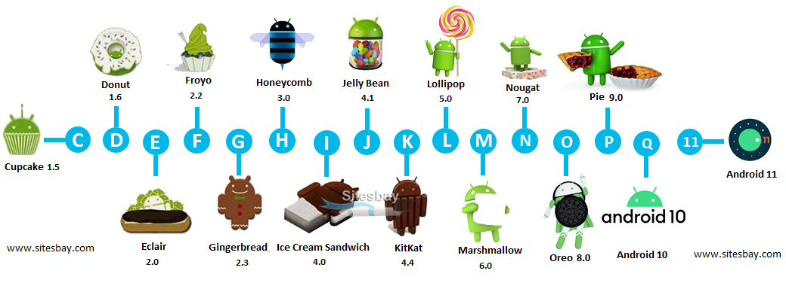
Versions of Android Operating System

Slide 6
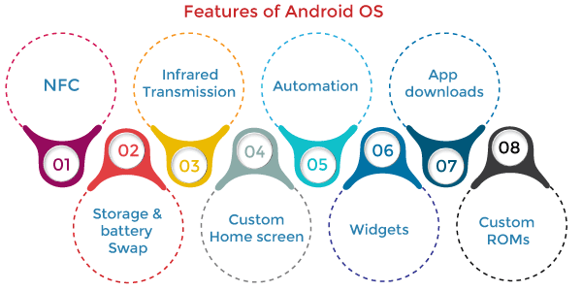
Features of Android Operating System

Slide 7
Features of Android Operating System
1. Near Field Communication (NFC):
Most Android devices support NFC, which allows electronic devices to interact across short distances easily. The main goal here is to create a payment option that is simpler than carrying cash or credit cards, and while the market hasn't exploded as many experts had predicted, there may be an alternative in the works, in the form of Bluetooth Low Energy (BLE).
2. Storage and Battery Swap:
Android phones also have unique hardware capabilities. Google's OS makes it possible to upgrade, replace, and remove your battery that no longer holds a charge. In addition, Android phones come with SD card slots for expandable storage.

Slide 8
Features of Android Operating System
3. Infrared Transmission
The Android operating system supports a built-in infrared transmitter that allows you to use your phone or tablet as a remote control.
4. Custom Home Screens
While it's possible to hack certain phones to customize the home screen, Android comes with this capability from the get-go. Download a third-party launcher like Apex, Nova, and you can add gestures, new shortcuts, or even performance enhancements for older-model devices.

Slide 9
Features of Android Operating System
5. Automation
The Tasker app allows control of app permissions and also automates them.
6. Widgets
Apps are versatile, but sometimes you want information at a glance instead of having to open an app and wait for it to load. Android widgets let you display just about any feature you choose on the home screen, including weather apps, music widgets, or productivity tools that helpfully remind you of upcoming meetings or approaching deadlines.

Slide 10
Features of Android Operating System
7. Wireless App Downloads
You can download apps on your PC by using the Android Market or third-party options like AppBrain. Then it automatically syncs them to your Droid, and no plugging is required.
8. Custom ROMs
Because the Android operating system is open-source, developers can twist the current OS and build their versions, which users can download and install in place of the stock OS. Some are filled with features, while others change the look and feel of a device. Chances are, if there's a feature you want, someone has already built a custom ROM for it.

Slide 11
Architecture of Android OS
The android architecture contains a different number of components to support any android device needs. Android software contains an open-source Linux Kernel with many C/C++ libraries exposed through application framework services. Among all the components, Linux Kernel provides the main operating system functions to Smartphone and Dalvik Virtual Machine (DVM) to provide a platform for running an android application
An android operating system is a stack of software components roughly divided into five sections and four main layers, as shown in the below architecture diagram.
1.Applications
2.Application Framework
3.Android Runtime
4.Platform Libraries
5.Linux Kernel

Slide 12
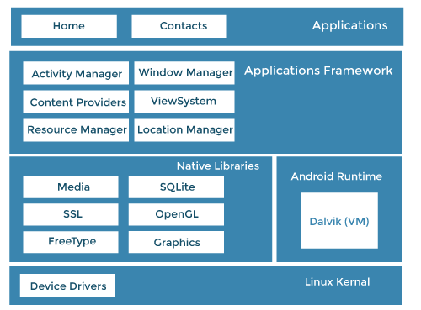
Architecture of Android OS

Slide 13
Architecture of Android OS
1. Applications:
An application is the top layer of the android architecture. The pre-installed applications like camera, gallery, home, contacts, etc., and third-party applications downloaded from the play store like games, chat applications, etc., will be installed on this layer.
It runs within the Android run time with the help of the classes and services provided by the application framework.

Slide 14
Architecture of Android OS
2. Application framework
Application Framework provides several important classes used to create an Android application. It provides a generic abstraction for hardware access and helps in managing the user interface with application resources. Generally, it provides the services with the help of which we can create a particular class and make that class helpful for the Applications creation.
It includes different types of services, such as activity manager, notification manager, view system, package manager etc., which are helpful for the development of our application according to the prerequisite.
The Application Framework layer provides many higher-level services to applications in the form of Java classes. Application developers are allowed to make use of these services in their applications.

Slide 15
Architecture of Android OS
The Android framework includes the following key services:
Activity Manager: Controls all aspects of the application lifecycle and activity stack.
Content Providers: Allows applications to publish and share data with other applications.
Resource Manager: Provides access to non-code embedded resources such as strings, color settings and user interface layouts.
Notifications Manager: Allows applications to display alerts and notifications to the user.
View System: An extensible set of views used to create application user interfaces.

Slide 16
Architecture of Android OS
3. Application runtime
Android Runtime environment contains components like core libraries and the Dalvik virtual machine (DVM). It provides the base for the application framework and powers our application with the help of the core libraries.
Like Java Virtual Machine (JVM), Dalvik Virtual Machine (DVM) is a register-based virtual machine designed and optimized for Android to ensure that a device can run multiple instances efficiently.
It depends on the layer Linux kernel for threading and low-level memory management. The core libraries enable us to implement android applications using the standard JAVA or Kotlin programming languages.

Slide 17
Architecture of Android OS
4. Platform libraries
The Platform Libraries include various C/C++ core libraries and Java-based libraries such as Media, Graphics, Surface Manager, OpenGL, etc., to support Android development.
app: Provides access to the application model and is the cornerstone of all Android applications.
content: Facilitates content access, publishing and messaging between applications and application components.
database: Used to access data published by content providers and includes SQLite database, management classes.
OpenGL: A Java interface to the OpenGL ES 3D graphics rendering API.
os: Provides applications with access to standard operating system services, including messages, system services and inter-process communication.
text: Used to render and manipulate text on a device display.

Slide 18
Architecture of Android OS Platform libraries
view: The fundamental building blocks of application user interfaces.
widget: A rich collection of pre-built user interface components such as buttons, labels, list views, layout managers, radio buttons etc.
WebKit: A set of classes intended to allow web-browsing capabilities to be built into applications.
media: Media library provides support to play and record an audio and video format.
surface manager: It is responsible for managing access to the display subsystem.
SQLite: It provides database support, and FreeType provides font support.
SSL: Secure Sockets Layer is a security technology to establish an encrypted link between a web server and a web browser.

Slide 19
Architecture of Android OS
5. Linux Kernel
Linux Kernel is the heart of the android architecture. It manages all the available drivers such as display, camera, Bluetooth, audio, memory, etc., required during the runtime.
The Linux Kernel will provide an abstraction layer between the device hardware and the other android architecture components. It is responsible for the management of memory, power, devices etc. The features of the Linux kernel are:
Security: The Linux kernel handles the security between the application and the system.
Memory Management: It efficiently handles memory management, thereby providing the freedom to develop our apps.
Process Management: It manages the process well, allocates resources to processes whenever they need them.
Network Stack: It effectively handles network communication.
Driver Model: It ensures that the application works properly on the device and hardware manufacturers responsible for building their drivers into the Linux build.

Slide 20
Privacy Leakages in Android
Android OS are inherently insecure in the way they handle our personal data. And while volumes of it leak all the time, there is no shortage of parties looking to put our data to malicious use.
Data leakage can be defined as an event in which classified information, e.g. sensitive, protected or confidential data has been viewed, stolen or used by somebody who is not authorized to do so. Data leakage causes serious and expensive problems to companies and organizations, because the number of events continues to rise.
Here are some of the top privacy concerns surrounding mobile apps:
1. Sensitive data tracking and permissions
2. Third-party data sharing
3. Malicious mobile apps
There are two main avenues, through which data leaks happen:
The first is via Google Services – a framework of functionalities embedded in the Android OS that serves as the foundation, on which various app features operate. If an app has to use the map interface, the Google Maps service provides all the map-related data it needs. It could be a legit app that needs to visualize a map. But it also could be malware sending it to cybercriminals. (Not to mention the company behind your legit app might also be gathering this data and selling it to advertisers.
The second avenue is internet browsing. The web browser is usually the most frequently used app on a device. It is where you do all your reading, web searches, online shopping, banking, and whatnot. It is also an app that stores all the login passwords you need for these services. Quite convenient for cybercriminals to have everything in one place, don’t you think? They certainly think so, and because of that, about half of leaking data happens to be extracted from browsers.

Slide 21
Privacy Leakages in Android
While some of information is harmless, such as screen resolution, data such as IMEI, IMSI, MAC address can be uniquely identify and track a user. This data can be misused by cybercriminals or state actors to violate a user’s privacy and take advantage of the leaked information to intercept phone calls or text messages.
Some android applications are known to leak data from user’s device. This data can potentially be sensitive. Data that is often leaked by Android applications include:
1.Phone model
2.Scree resolution
3.Phone MAC address
4.Carrier (Telecom Provider)
5.Network (WiFi, 2G, 3G, 4G, 5G)
6.Android ID
7.IMSI (International Mobile Subscriber Identity)
8.IMEI (International Mobile Equipment Identity)

Slide 22
Privacy Leakages in Android
There are a harmful of things others personal data could be used for:
Spread malware. An email account comes with a list of contacts – people who are prone to opening messages they received from you. If someone uses your account to distribute some viruses, Trojans, and ransomware, that will get the with their guard down.
Improve malware. You read that right. If hackers have access to your system’s logs they can read how it deflected certain types of malware – and use that knowledge to design improved malware.
Get credentials. An email inbox usually is where all the credentials for other services you use get sent. By hacking your account, criminals could potentially access all your other ones.
Blackmail. Everyone has conversations that better stay private. Cybercriminals could intercept emails and messages and threaten to make the contents public unless you pay up.
Identity theft. Details such as address, birthdate, and social security number could be used by a criminal to open up a credit account in your name. This could have terrible consequences, ranging from your savings being drained to you being framed for crimes committed by impostors.

Slide 23
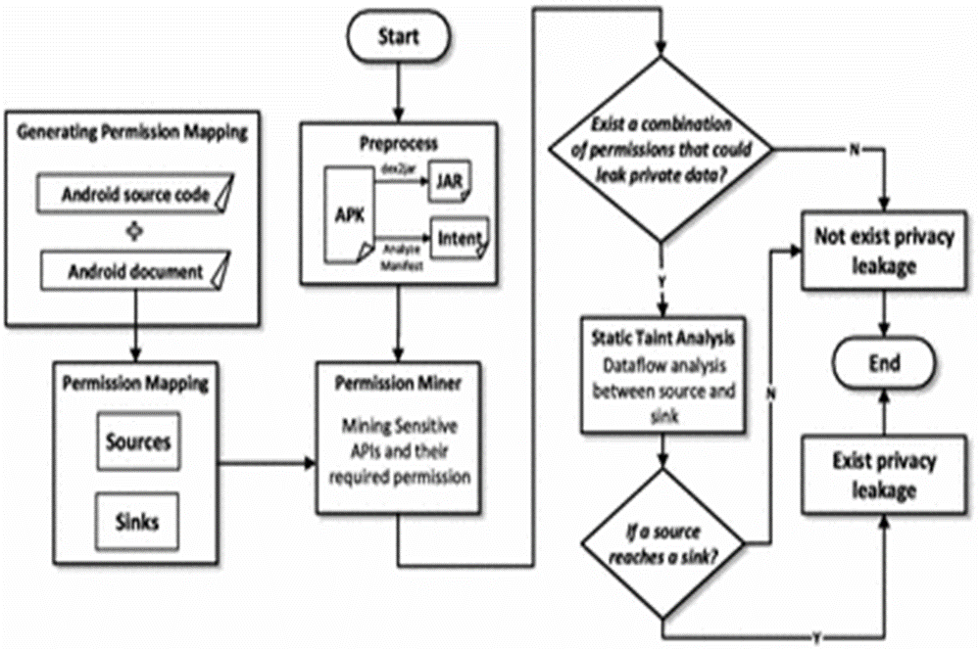
Privacy Leakage Identification Methods
Several method have been carried out by researchers in detecting android malware. now we look a flow chart for detecting privacy leakage.

Slide 24
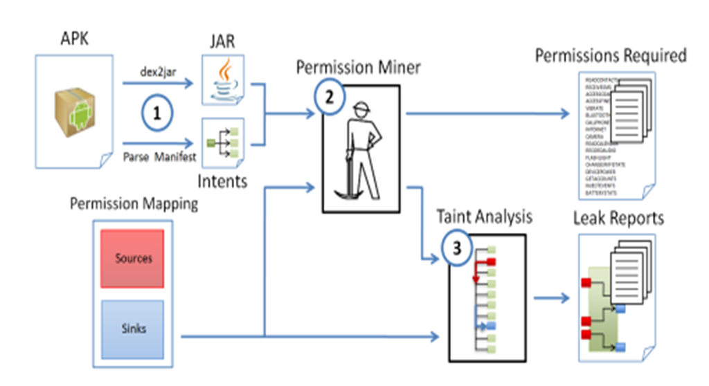
Privacy Leakage Identification Methods
Android Leaks Analysis Process:
1. Preprocessing.
2. Recursive call stack generation to determine where permissions are required.
3. Dataflow analysis between sources and sinks.

Slide 25
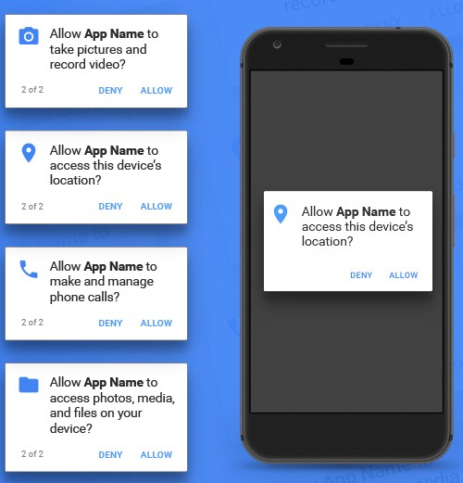
Permissions in Android
Android permissions provide controls that increase user awareness and limit an app’s access to sensitive data. Configuring permissions on Android 8.0 and lower includes allow listing, without which privileged apps are disabled, even if they’re in the priv-app path. On Android 9 and higher, a device that tries to use apps that aren’t properly allow listed won’t boot.
Android categorizes permissions into different type:
1.install-time permissions
2.runtime permissions
3.special permissions

Slide 26
Permissions in Android
The purpose of a permission is to protect the privacy of an Android user. Android apps must request permission to access sensitive user data (such as contacts and SMS), as well as certain system features (such as camera and internet). Depending on the feature, the system might grant the permission automatically or might prompt the user to approve the request.
Permissions are classified in two types in Android : 1.Normal permission 2.Dangerous permission.
The Normal permissions do not directly affect the user’s privacy. If application lists a normal permission in its manifest, then these permissions will be automatically granted by the system upon installation. Check and change data connection: Include network state, Wi-Fi State, Bluetooth, Internet, etc.
The Dangerous permissions includes nine permission groups where apps are somehow connected with the user’s privacy or security. In turn, each group contains several permissions an app can request.
If a user approves one of the permissions, the app gets all of the permissions from the same group automatically, without additional confirmation. For example, if an app gets permission to read SMS messages, then it will be also able to send SMS messages, read MMS messages, and perform other operations from this group.
The increased protections against Potentially Harmful Apps (PHAs) to improve:
1.Transparency into potentially harmful app behavior.
2.User control over app behavior.
3.App developers' discretion when using private data, protected by permissions.

Slide 27
Permission vs. Privacy Leakage
App permissions help support user privacy by protecting access to the following:
Restricted data, such as system state and a user's contact information.
Restricted actions, such as connecting to a paired device and recording audio.
So using permission we can restricted some private data and action so that privacy leakage is less.

Slide 28
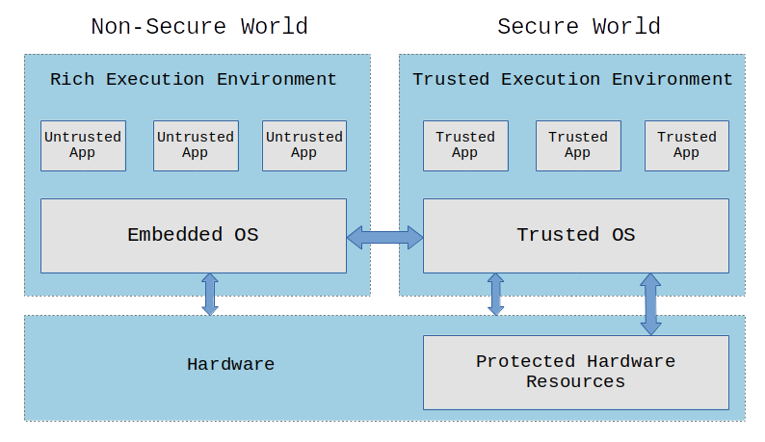
Trusted vs. Untrusted Apps
Any source that is verified by Google or some other recognized agencies like the Samsung and Amazon is referred to as trusted sources.
Any Source that is not vetted by Google or any other recognized agency can be termed as unknown source. sometimes unknown source are untrusted source.

Slide 29
Trusted vs. Untrusted Apps
Trusted apps
Untrusted Apps
If some apps are being installed from trusted sources like Google Play or Amazon App store, then those apps are trusted and there is no risk of safety and security breach.
To avoid security breach, some steps should be followed:
1.Not installing unnecessary apps
2.Installing apps from official play store
3.Checking the app permissions
4.Researching about the app before installing
5.Installing a virus scanner etc.
Google places some restrictions on launching apps. When the developers refuse to accept all those restrictions, they publish their apps on private platforms. And those local platforms are unknown to us.
Not all unknown sources are insecure, but sometimes viruses and Trojans enter to those sources. Though Google scans check those every time some items are being fetched, security breach is still possible.
To avoid this security breach, before granting any permission to any app downloaded from unknown resource, proper research should be made.

Slide 30
Privacy Risks vs. Trusted & Untrusted Apps
All trusted apps are not safe and all untrusted apps are not risky!
Maximum apps downloaded from known and trusted sources are generally safe cause those trusted sources take necessary steps to ensure security to data. But still some hackers can target famous apps to get access to user’s valuable information like- passwords, bank account number, security numbers etc. These information can be misused!
Again, there are not enough security measures taken in the untrusted sources, so the apps downloaded from those sources are risky.
to avoid security breach, users should be more careful about granting permission and access to the apps downloaded from both trusted and untrusted sources. Only the required permission should be given to the apps. Before installing any app from the untrusted source, users should install some trusted anti-virus apps or enable default security app of the android device to prevent that installation if the app is not safe. Users should stop downloading unnecessary and potentially risky apps to prevent security breach.

Slide 31
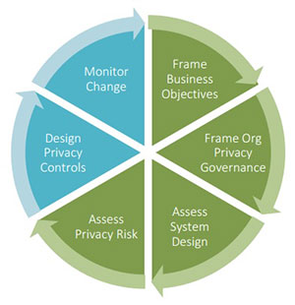
Privacy Risk Assessment
Privacy Risk management framework
Risk assessment is a systematic process of evaluating the potential risks that may be involved in some app functions or permissions. Mobile apps pose great privacy risks to their users. Developers and testers can leverage the more matured techniques to identify and fix privacy issues, thus improving the quality of the apps under assessment.
Privacy risk assessment aims to understand the privacy risk posed by an app. The source of risk may vary, and different author may consider different aspects to assess the risk e.g., permissions, network connections etc. The risk assessment output maybe qualitative (a risk level) or quantitative (a risk score).

Slide 32
Risk Assessment Methods.
Evaluate the security risk of mobile applications using various assessment methods. These methods are generally categorized into static analysis, dynamic analysis, and grey-box analysis.
Risk Assessment Method
dynamic analysis(Black box)
grey-box
static analysis
(white box)

Slide 33
Static analysis
Static Analysis Static Analysis, also called white-box analysis, is the assessment of the source code of software for vulnerabilities and is carried out without the execution of the program . This method allows for careful evaluation of the structure of the program to review it for privacy data leaks, permission misuse, vulnerabilities, and code verification. It does not depend on compilers and compiler environments making 22 5.1. Results for Literature Analysis 23 it possible to find errors that might surface years later.
techniques that fall under static analysis:
1.Control-flow analysis.
2.dataflow analysis.
3. lexical analysis.
4.static taint analysis

Slide 34
Dynamic analysis
Dynamic Analysis, also known as black-box analysis, is another method of assessing mobile applications for security flaws. It requires the execution of the program being tested in a sandbox which replicates the exact environment of the application. Various attacks are then simulated and the software is monitored to identify where it might default.
Techniques that adopt dynamic analysis is :
1.dynamic taint analysis
2.behavioral analysis.

Slide 35
Grey-box analysis
Grey box analysis is a hybrid method used to identify software flaws and is a combination of both static and dynamic. In this method of testing, the source code of the application is partially known to allow for better development of test cases Techniques that adopt dynamic analysis include regression analysis, pattern testing, and matrix testing .

